Slide 1
Jumping Automata Must Pay!
Shaull Almagor & Ishai Salgado Technion

Slide 2
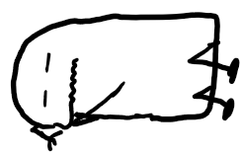
Jumping Automata Must Pay!
WHAT are jumping automata?
WHY must they pay?
WHO cares?

Slide 3
Automata
Transition
Initial State
Left marker
Word
Right marker
State
a
$$⊢$$ | a | b | a | b | a | a | $$⊣$$
$$q_{0}$$
$$q_{1}$$
$$⊢$$ |  |  |  |  |  |  | $$⊣$$
b
Tape
Head
a
Automaton
a,b
$$q_{2}$$
Accepting State

Slide 4
Automata
a
$$q_{0}$$
$$q_{1}$$
$$⊢$$ | a | b | a | b | a | a | $$⊣$$
b
a
$$q_{2}$$
ababaa is accepted.
The language of the automaton: $L\left(A\right)=\{w∣w$is accepted$\}$
$$L\left(A\right)={\left(ab\right)}^{∗}aa$$

Slide 5
Jumping Automata
Motivation:
Memory access is not always sequential.
Commutative Closure of Regular Languages.
Jumping Automata can read the input word non-sequentially.
Introduced by Meduna and Zemek, 2012.
Studied by Fernau, Paramasivan, Schmid & Vorel.
a
$$q_{0}$$
$$q_{1}$$
b
$$⊢$$ | b | a | a | a | a | b | $$⊣$$
a
a,b
$$q_{2}$$

Slide 6
Jumping Automata
a
$$q_{0}$$
$$q_{1}$$
b
$$⊢$$ | b | a | a | a | a | b | $$⊣$$
a
$$0$$ | 1 | 2 | 3 | 4 | 5 | 6 | $$7$$
a,b
$$q_{2}$$
baaaab is accepted by the Jumping Automaton
The jumping language of the automaton: $J\left(A\right)=\{w∣w$is accepted with some jump sequence$\}$
$J\left(A\right)=\{w∣w$is a permutation of some $w^{′}∈L(A)\}$
Accepting jump sequence:
$$0$$ | 2 | 1 | 4 | 6 | 5 | 3 | $$7$$
ababaa is the actual word read
“Gland dance fail”$∈L(A)$
$⇒$ “Gandalf Iceland ”$∈J(A)$

Slide 7
Jumping Automata Must Pay!
WHAT are jumping automata?
WHY must they pay?
WHO cares?

Slide 8
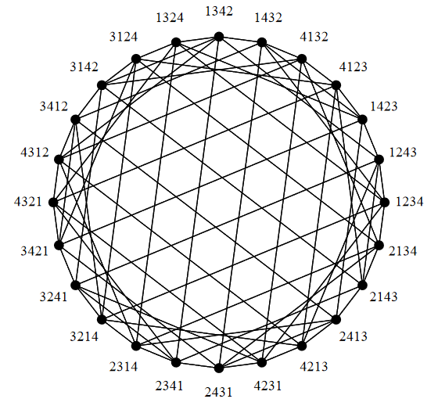
Jumping Automata – Motivation Revisited
Memory access is not always sequential.
Commutative closure.
Tape-based memory
Expensive to move head
Spinning disk
Expensive to change direction
Permutation distance
Expensive to swap two letters
This Photo by Unknown Author is licensed under CC BY-NC

Slide 9
Jumping Automata Must Pay!
WHAT are jumping automata?
WHY must they pay?
WHO cares?

Slide 10
Jumping Automata – Motivation Revisited
memory access is not always sequential.
commutative closure.
Tape-based memory
Expensive to move head
Spinning disk
Expensive to change direction
Permutation distance
Expensive to swap two letters
Absolute Distance Semantics
Reversal Semantics
Hamming Semantics
This Photo by Unknown Author is licensed under CC BY-NC

Slide 11
Quantitative Semantics for Jumping Automata
Absolute Distance Semantics
Reversal Semantics
Hamming Semantics
$$⊢$$ | b | a | a | a | a | b | $$⊣$$
$$⊢$$ | b | a | a | a | a | b | $$⊣$$
$$⊢$$ | b | a | a | a | a | b | $$⊣$$
$$0$$ | 1 | 2 | 3 | 4 | 5 | 6 | $$7$$
$$0$$ | 1 | 2 | 3 | 4 | 5 | 6 | $$7$$
$$0$$ | 1 | 2 | 3 | 4 | 5 | 6 | $$7$$
$$0$$ | 2 | 1 | 4 | 6 | 5 | 3 | $$7$$
$$0$$ | 2 | 1 | 4 | 6 | 5 | 3 | $$7$$
$$0$$ | 2 | 1 | 4 | 6 | 5 | 3 | $$7$$
$$1$$ | 0 | 2 | 1 | 0 | 1 | 3
$$→$$ | $$←$$ | $$→$$ | $$→$$ | $$←$$ | $$←$$ | $$→$$
$$⊢$$ | a | b | a | b | a | a | $$⊣$$
Cost of run: $8$
Cost of run: $4$
Cost of run: $4$
Cost of a word $w$: minimal cost of a run on $w$
Language is a function $L_{A}:Σ^{∗}→ℕ$
The Membership Problem:
Given a JA $A$ and a word $w$, compute $L_{A}(w)$.
The Boundedness Problem:
Given a JA $A$ and $k∈ℕ$, decide if $L_{A}\left(w\right)≤k$ for all $w.$

Slide 12
Bob’s Pogo Sticks: Pay Once - Jump Forever!
SALE!
SALE!
SALE!
Just €29.99
Warning: Pogo stick may cause immortality. Your experience of “forever” may vary.

Slide 13
The Absolute Distance Semantics
The Membership Problem:
Given a JA $A$ and a word $w$, compute $L_{A}(w)$.
$$⊢$$ | b | a | a | a | a | b | $$⊣$$
The Membership Problem (Decision version):
$$0$$ | 1 | 2 | 3 | 4 | 5 | 6 | $$7$$
$$0$$ | 2 | 1 | 4 | 6 | 5 | 3 | $$7$$
Given a JA $A,$a word $w$ and $k∈ℕ$, is $L_{A}\left(w\right)≤k$?
$$1$$ | 0 | 2 | 1 | 0 | 1 | 3
Cost of run: $8$
Observation:
For $w$ of length $n$ we have $L_{A}\left(w\right)≤n^{2}$
Theorem: The Membership Problem is NP-complete.
Proof:
NP-membership follows from the observation.
NP-hardness follows from hardness of membership for Jumping automata.

Slide 14
The Absolute Distance Semantics
The Boundedness Problem:
Given a JA $A$ and $k∈ℕ$, decide if $L_{A}\left(w\right)≤k$ for all $w.$
$$⊢$$ | b | a | a | a | a | b | $$⊣$$
Important Lemma:
$$0$$ | 1 | 2 | 3 | 4 | 5 | 6 | $$7$$
If $L_{A}\left(w\right)≤k$, then the jumping head is always within distance $k$ of the sequential head.
$$0$$ | 2 | 1 | 4 | 6 | 5 | 3 | $$7$$
$$1$$ | 0 | 2 | 1 | 0 | 1 | 3
Cost of run: $8$
$$⊢$$ |  |  |  |  |  |  |  |  |  |  |  |  |  |  |  |  |  |  |  |  |  |  |  |  |  |  |  |  | $$⊣$$
$$≤k$$
$$≤k$$

Slide 15
The Absolute Distance Semantics
The Boundedness Problem:
Given a JA $A$ and $k∈ℕ$, decide if $L_{A}\left(w\right)≤k$ for all $w.$
$$⊢$$ | b | a | a | a | a | b | $$⊣$$
Important Lemma:
$$0$$ | 1 | 2 | 3 | 4 | 5 | 6 | $$7$$
If $L_{A}\left(w\right)≤k$, then the jumping head is always within distance $k$ of the sequential head.
$$0$$ | 2 | 1 | 4 | 6 | 5 | 3 | $$7$$
$$1$$ | 0 | 2 | 1 | 0 | 1 | 3
Cost of run: $8$
$$⊢$$ |  |  |  |  |  |  |  |  |  |  |  |  |  |  |  |  |  |  |  |  |  |  |  |  |  |  |  |  | $$⊣$$
$$≤k$$
$$≤k$$

Slide 16
The Absolute Distance Semantics
The Boundedness Problem:
Given a JA $A$ and $k∈ℕ$, decide if $L_{A}\left(w\right)≤k$ for all $w.$
$$⊢$$ | b | a | a | a | a | b | $$⊣$$
Important Lemma:
$$0$$ | 1 | 2 | 3 | 4 | 5 | 6 | $$7$$
If $L_{A}\left(w\right)≤k$, then the jumping head is always within distance $k$ of the sequential head.
$$0$$ | 2 | 1 | 4 | 6 | 5 | 3 | $$7$$
$$1$$ | 0 | 2 | 1 | 0 | 1 | 3
Cost of run: $8$
Theorem: We can construct an NFA for $\{w∣L_{A}\left(w\right)≤k\}$.
Proof: NFA keeps track of a window of size $±k$ around sequential head, guesses jump sequence.
Corollary:
The Boundedness Problem is decidable.

Slide 17
Bob’s Tampolines: High Ceiling – High Prices!
SALE!
SALE!
Just €129.99
Warning: trampolines may launch you beyond escape velocity.

Slide 18
The Reversal Semantics
The Membership Problem:
Given a JA $A$ and a word $w$, compute $L_{A}(w)$.
$$⊢$$ | b | a | a | a | a | b | $$⊣$$
The Membership Problem (Decision version):
$$0$$ | 1 | 2 | 3 | 4 | 5 | 6 | $$7$$
Given a JA $A,$a word $w$ and $k∈ℕ$, is $L_{A}\left(w\right)≤k$?
$$0$$ | 2 | 1 | 4 | 6 | 5 | 3 | $$7$$
$$→$$ | $$←$$ | $$→$$ | $$→$$ | $$←$$ | $$←$$ | $$→$$
Observation:
For $w$ of length $n$ we have $L_{A}\left(w\right)≤n$
Cost of run: $4$
Theorem: The Membership Problem is NP-complete.
Proof:
NP-membership follows from the observation.
NP-hardness follows from hardness of membership for Jumping automata.

Slide 19
The Reversal Semantics
The Boundedness Problem:
Given a JA $A$ and $k∈ℕ$, decide if $L_{A}\left(w\right)≤k$ for all $w.$
$$⊢$$ | b | a | a | a | a | b | $$⊣$$
Important Lemma:
$$0$$ | 1 | 2 | 3 | 4 | 5 | 6 | $$7$$
$L_{A}\left(w\right)≤k$ iff there exist words $s_{1},…,s_{k+1}$ such that:
$s_{1}s_{2}⋯s_{k+1}∈L(A)$
$w∈$shuffle$(s_{1},s_{2}^{R},s_{3},s_{4}^{R},…, s_{k+1})$
$$0$$ | 2 | 1 | 4 | 6 | 5 | 3 | $$7$$
$$→$$ | $$←$$ | $$→$$ | $$→$$ | $$←$$ | $$←$$ | $$→$$
Cost of run: $4$
$$⊢$$
a
b
c
d
e
f
g
h
i
j
k
l
m
n
o
p
$$⊣$$
dfknliheabcgjmop$∈L\left(A\right)$
$s_{1}=$dfkn
$s_{2}=$lihea
$s_{3}=$bcgjmop
$w∈$shuffle(dfkn,aehil,bcgjmop)

Slide 20
The Reversal Semantics
The Boundedness Problem:
Given a JA $A$ and $k∈ℕ$, decide if $L_{A}\left(w\right)≤k$ for all $w.$
$$⊢$$ | b | a | a | a | a | b | $$⊣$$
Important Lemma:
$$0$$ | 1 | 2 | 3 | 4 | 5 | 6 | $$7$$
$L_{A}\left(w\right)≤k$ iff there exist words $s_{1},…,s_{k+1}$ such that:
$s_{1}s_{2}⋯s_{k+1}∈L(A)$
$w∈$shuffle$(s_{1},s_{2}^{R},s_{3},s_{4}^{R},…, s_{k+1})$
$$0$$ | 2 | 1 | 4 | 6 | 5 | 3 | $$7$$
$$→$$ | $$←$$ | $$→$$ | $$→$$ | $$←$$ | $$←$$ | $$→$$
Cost of run: $4$
Theorem: We can construct an NFA for $\{w∣L_{A}\left(w\right)≤k\}$.
Proof:$k$ copies of $A$ and $A^{R}$ guess the decomposition of the word to the shuffle.
Corollary:
The Boundedness Problem is decidable.

Slide 21
Bob’s Demolitions: We Jump – You Pay!
SALE!
SALE!
Just €1299.99
Warning: damage guaranteed to property, physical and mental health.

Slide 22
The Hamming Semantics
The Membership Problem:
Given a JA $A$ and a word $w$, compute $L_{A}(w)$.
$$⊢$$ | b | a | a | a | a | b | $$⊣$$
$$0$$ | 1 | 2 | 3 | 4 | 5 | 6 | $$7$$
The Membership Problem (Decision version):
Given a JA $A,$a word $w$ and $k∈ℕ$, is $L_{A}\left(w\right)≤k$?
$$0$$ | 2 | 1 | 4 | 6 | 5 | 3 | $$7$$
$$⊢$$ | a | b | a | b | a | a | $$⊣$$
Observation:
Cost of run: $4$
For $w$ of length $n$ we have $L_{A}\left(w\right)≤n$
Theorem: The Membership Problem is NP-complete.
Proof:
NP-membership follows from the observation.
NP-hardness follows from hardness of membership for Jumping automata.

Slide 23
The Hamming Semantics
The Boundedness Problem:
Given a JA $A$ and $k∈ℕ$, decide if $L_{A}\left(w\right)≤k$ for all $w.$
$$⊢$$ | b | a | a | a | a | b | $$⊣$$
$$0$$ | 1 | 2 | 3 | 4 | 5 | 6 | $$7$$
Theorem: We can construct an NFA for $\{w∣L_{A}\left(w\right)≤k\}$.
$$0$$ | 2 | 1 | 4 | 6 | 5 | 3 | $$7$$
Proof: Simulate NFA for $A$, but allow replacing letter.
For each letter $σ$, keep track of how many $σ$ we swapped in/out, in range $\left\{−k,…,k\right\}.$ Check that balances are 0 at the end.
$$⊢$$ | a | b | a | b | a | a | $$⊣$$
Cost of run: $4$
Corollary:
The Boundedness Problem is decidable.

Slide 24
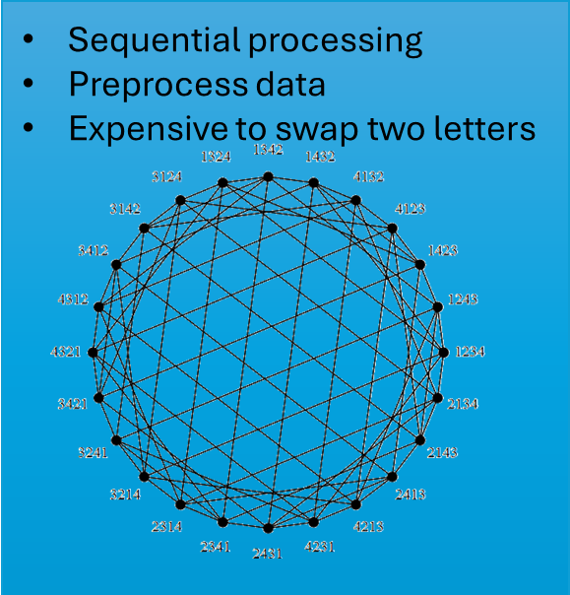
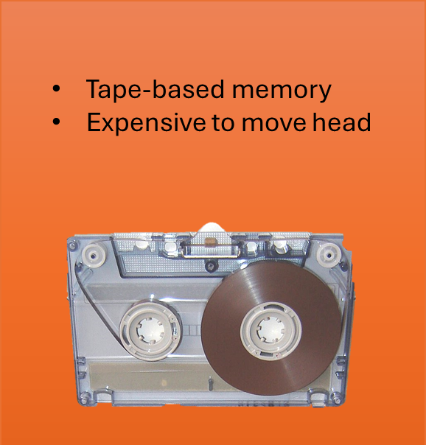
Interplay Between the Semantics
Theorem:
Let $A$ be a jumping automaton, then:
If $L_{A}^{ABS}$ is bounded, then $L_{A}^{HAM}$ is bounded.
If $L_{A}^{HAM}$ is bounded, then $L_{A}^{REV}$ is bounded.
No Other Implications:
REV | HAM | ABS | Language
Bounded | Bounded | Bounded | $${\left(a+b\right)}^{∗}$$
Bounded | Bounded | Unbounded (${a b}^{n}$) | $${\left(a+b\right)}^{∗}a$$
Bounded | Unbounded$(b^{n}a^{n})$ | Unbounded ${(b}^{n}a)$ | $$a^{∗}b^{∗}$$
Unbounded $(b^{n}a^{n})$ | Unbounded ${\left(ba\right)}^{n}$ | Unbounded $(a^{n}b^{n})$ | $${\left(ab\right)}^{∗}$$

Slide 25
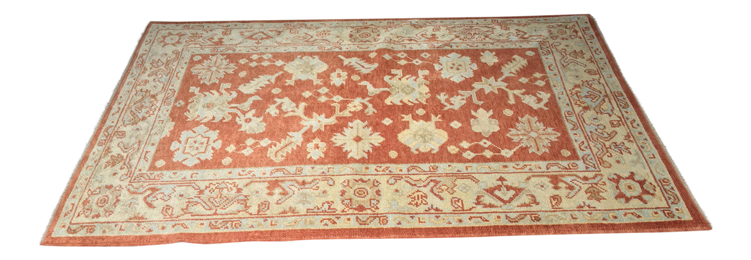
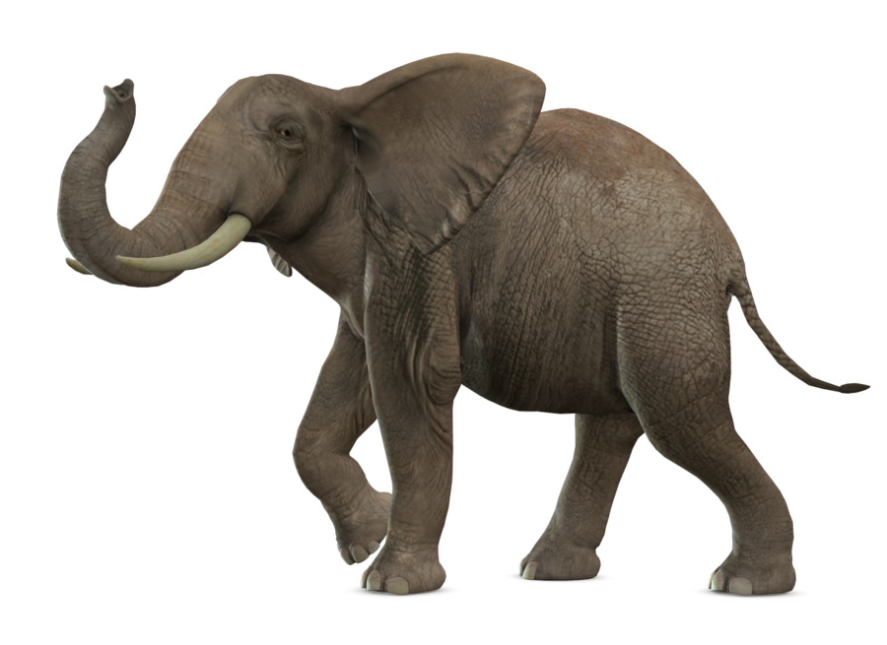

Slide 26
Existential Boundedness
The Boundedness Problem:
Given a JA $A$ and $k∈ℕ$, decide if $L_{A}\left(w\right)≤k$ for all $w.$
The Existential-Boundedness Problem:
Given a JA $A$ decide if $∃k∈ℕ$ such that $L_{A}\left(w\right)≤k$ for all $w.$
Seems much harder.
We don’t have any good lower-bounds on $k.$
Partial solution for a subclass of ABS, using Boundedness of Weighted Automata.
If you have any ideas – let me know!

Slide 27
Summary
3 Semantics
Absolute Distance Semantics
Reversal Semantics
Hamming Semantics
$$⊢$$ | b | a | a | a | a | b | $$⊣$$
$$⊢$$ | b | a | a | a | a | b | $$⊣$$
$$⊢$$ | b | a | a | a | a | b | $$⊣$$
$$0$$ | 1 | 2 | 3 | 4 | 5 | 6 | $$7$$
$$0$$ | 1 | 2 | 3 | 4 | 5 | 6 | $$7$$
$$0$$ | 1 | 2 | 3 | 4 | 5 | 6 | $$7$$
$$0$$ | 2 | 1 | 4 | 6 | 5 | 3 | $$7$$
$$0$$ | 2 | 1 | 4 | 6 | 5 | 3 | $$7$$
$$0$$ | 2 | 1 | 4 | 6 | 5 | 3 | $$7$$
$$1$$ | 0 | 2 | 1 | 0 | 1 | 3
$$→$$ | $$←$$ | $$→$$ | $$→$$ | $$←$$ | $$←$$ | $$→$$
$$⊢$$ | a | b | a | b | a | a | $$⊣$$
NP-Complete
The Membership Problem:
Given a JA $A$ and a word $w$, compute $L_{A}(w)$.
Decidable
The Boundedness Problem:
Interplay
Given a JA $A$ and $k∈ℕ$, decide if $L_{A}\left(w\right)≤k$ for all $w.$
The Existential-Boundedness Problem:
Open!
Given a JA $A$ decide if $∃k∈ℕ$ such that $L_{A}\left(w\right)≤k$ for all $w.$
Thank you!
This Photo by Unknown Author is licensed under CC BY-NC

